Slide 1
ECE 3436 Microprocessor Systems Notes 5a: Shift, Rotate, & Logical Operations
Ph.D. Jianfeng Zheng
Dept. ECE, Univ. of Houston
Email: jzheng4@central.uh.edu
Feb 17, 2026
Adapted from notes by Dr. Diana De La Rosa-Pohl

Slide 2
Today’s agenda in ECE 3436
Review N, Z, C, and V condition flags.
Perform shift operations on register data
Perform rotate operations on register data
Perform logical operations on register data

Slide 3
Shift instructions
R1
B7 | B6 | B5 | B4 | B3 | B2 | B1 | B0
1 | 0 | 1 | 1 | 0 | 0 | 1 | 0
8-bit example
LSL – logical shift left
LSR – logical shift right
ASR – arithmetic shift right
LSL R0, R1, #3
Ans → 1001.0000
LSR R0, R1, #2
Ans → 0010.1100
ASR R0, R1, #4
Ans → 1111.1011

Slide 4
Shift instructions
R1
B7 | B6 | B5 | B4 | B3 | B2 | B1 | B0
0 | 0 | 1 | 1 | 0 | 0 | 1 | 0
8-bit example
What is the result in R0
ASR R0, R1, #3
Ans → 0000.0110 or
Ans → 1110.0110

Slide 5
Shift instructions
R1 = 1100.1001.0000.0001.0011.0010.0001.1001
32-bit example
What is the result in R0
ASR R0, R1, #3
Ans → 1111.1001.0010.0000.0010.0110.0100.0011

Slide 6
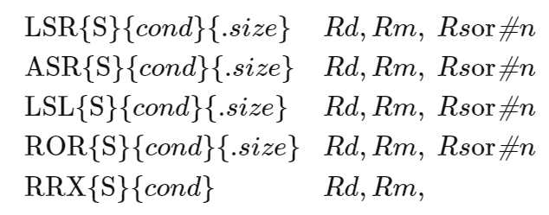
Shift Multiplication (LSL)
Logical Shift Left
Multiply by 2 (for each shift)
Multiply by powers of 2 only
EX.: LSL R1, R0, #2
0 | 0 | 0 | 1 | 0 | 0 | 1 | 0
• • •
0 | 1 | 0 | 0 | 1 | 0 | 0 | 0
31 | 30 | 29 | 28 | 27 | 26 |  |  |  | 1 | 0
C
Logical Shift Left
LSL
0≤n≤31
0

Slide 7
Shift Multiplication (LSL)
4-bit Practice (single shift to left)
#1
0 | 1 | 0 | 0
+4
#3
0 | 0 | 1 | 1
+3
#2
0 | 1 | 1 | 0
+6
#4
1 | 1 | 1 | 1
+15 or −1

Slide 8
Shift Multiplication (LSL)
8-bit Practice (single shift to left)
#1
0 | 1 | 0 | 0 | 0 | 0 | 0 | 0
+64
#3
1 | 0 | 0 | 0 | 0 | 0 | 0 | 0
+128 or −128
#2
0 | 0 | 0 | 1 | 0 | 0 | 0 | 1
+17
#4
1 | 1 | 1 | 1 | 1 | 1 | 1 | 1
+255 or −1

Slide 9
Unsigned Shift Division (LSR)
Logical Shift Right
Divide by 2 (for each shift)
Divide by powers of 2 only
EX.: LSR R1, R0, #2
0 | 0 | 0 | 1 | 0 | 0 | 1 | 0
• • •
0 | 0 | 0 | 0 | 0 | 0 | 1 | 0
31 | 30 | 29 | 28 | 27 | 26 |  |  |  | 1 | 0
C
Logical Shift Right
LSR
1≤n≤32
0

Slide 10
Unsigned Shift Division (LSR)
4-bit Practice (single shift to right)
#1
1 | 0 | 0 | 0
+4
#3
0 | 0 | 1 | 1
+3
#2
0 | 1 | 1 | 0
+6
#4
0 | 1 | 1 | 1
+7

Slide 11
Unsigned Shift Division (LSR)
8-bit Practice (single shift to right)
#1
1 | 0 | 0 | 0 | 1 | 0 | 0 | 0
+136
#3
1 | 0 | 0 | 0 | 0 | 0 | 0 | 0
+128 or −128
#2
0 | 1 | 1 | 0 | 0 | 1 | 1 | 0
+102
#4
1 | 1 | 1 | 1 | 1 | 1 | 1 | 1
+255 or −1

Slide 12
Signed Shift Division (ASR)
Arithmetic Shift Right
Divide by 2 (for each shift)
Divide by powers of 2 only
EX.: ASR R1, R0, #1
1 | 0 | 0 | 1 | 0 | 0 | 1 | 0
• • •
1 | 1 | 0 | 0 | 1 | 0 | 0 | 1
31 | 30 | 29 | 28 | 27 | 26 |  |  |  | 1 | 0
C
Arithmetic Shift Right
ASR
1≤n≤32

Slide 13
Signed Shift Division (ASR)
4-bit Two’s Complement Practice (single shift to right)
#1
1 | 0 | 0 | 0
−8
#3
1 | 1 | 0 | 1
−3
#2
0 | 0 | 1 | 0
?
#4
1 | 0 | 0 | 1
−7

Slide 14
Signed Shift Division (ASR)
8-bit Practice (single shift to right)
#1
1 | 0 | 0 | 0 | 1 | 0 | 0 | 0
−120
#3
1 | 0 | 0 | 0 | 0 | 0 | 0 | 0
−128
#2
0 | 1 | 1 | 0 | 0 | 1 | 1 | 0
+102
#4
1 | 1 | 1 | 1 | 1 | 1 | 1 | 1
−1

Slide 15
Shift Operations w/carry bit
31 | 30 | 29 | 28 | 27 | 26 |  |  |  | 1 | 0
C
Logical Shift Right
LSR
1≤n≤32
0
31 | 30 | 29 | 28 | 27 | 26 |  |  |  | 1 | 0
C
Arithmetic Shift Right
ASR
1≤n≤32
31 | 30 | 29 | 28 | 27 | 26 |  |  |  | 1 | 0
C
Logical Shift Left
LSL
0≤n≤31
0
Use the ASR instruction when manipulating signed numbers, and use the LSR instruction when shifting unsigned numbers.

Slide 16
Rotate operations
R1
B7 | B6 | B5 | B4 | B3 | B2 | B1 | B0
1 | 0 | 1 | 1 | 0 | 0 | 1 | 0
8-bit example
ROR – rotate right
RRX – rotate right w/extend
ROR R0, R1, #1
Ans → ??
RRX R0, R1
Ans → ??

Slide 17
Rotate Operations
31 | 30 | 29 | 28 | 27 | 26 |  |  |  | 1 | 0
C
Rotate Shift Right
ROR
1≤n≤32
31 | 30 | 29 | 28 | 27 | 26 |  |  |  | 1 | 0
C
Rotate Right Extended
RRX
0≤n≤31

Slide 18
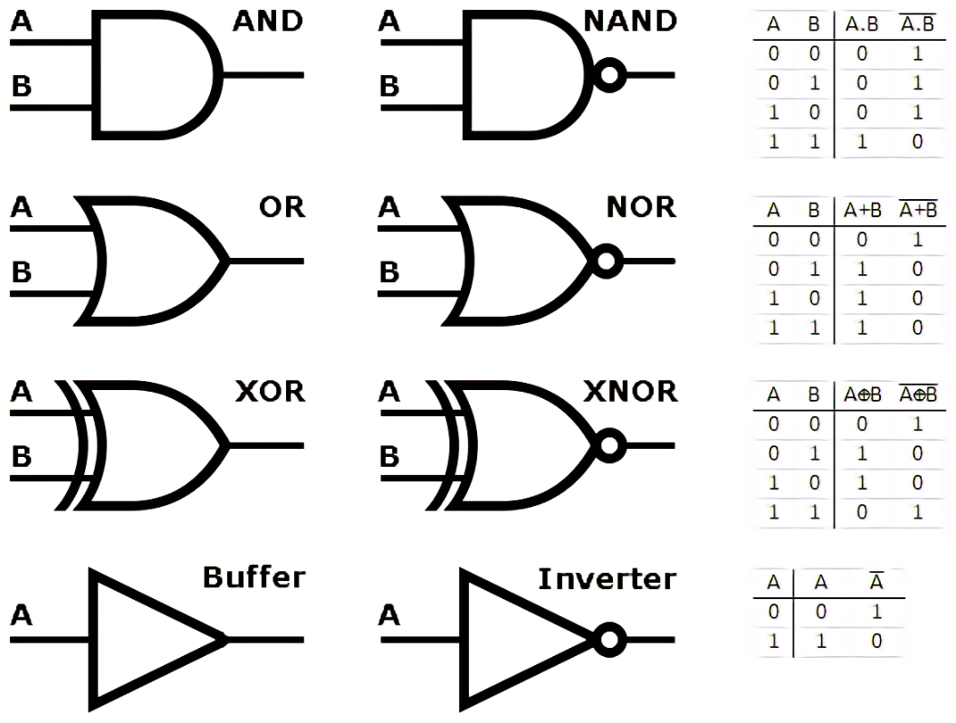
Inverter (Not) Truth Table
And Truth Table
Symbol
Symbol
In_A | In_B | Out
0 | 0 | 0
1 | 0 | 0
0 | 1 | 0
1 | 1 | 1
In | Out
1 | 0
0 | 1
Assembly Instructions
MVN{S} Rd, <op2> ;Rd=~op2
Assembly Instructions
AND{S} {Rd,} Rn, <op2> ;Rd=Rn&op2

Slide 19
OR Truth Table
Exclusive OR (XOR) Truth Table
Symbol
Symbol
In_A | In_B | Out
0 | 0 | 0
1 | 0 | 1
0 | 1 | 1
1 | 1 | 1
In_A | In_B | Out
0 | 0 | 0
1 | 0 | 1
0 | 1 | 1
1 | 1 | 0
Assembly Instructions
ORR{S} {Rd,} Rn, <op2> ;Rd=Rn|op2
Assembly Instructions
EOR{S} {Rd,} Rn, <op2> ;Rd=Rn^op2

Slide 20
BIT Clear Truth Table
OR NOT Truth Table
Symbol
Symbol
In_A | In_B | Out
0 | 0 | 0
1 | 0 | 1
0 | 1 | 0
1 | 1 | 0
In_A | In_B | Out
0 | 0 | 1
1 | 0 | 1
0 | 1 | 0
1 | 1 | 1
Assembly Instructions
BIC{S} {Rd,} Rn, <op2> ;Rd=Rn&(~op2)
Assembly Instructions
ORN{S} {Rd,} Rn, <op2> ;Rd=Rn|(~op2)

Slide 21
Quick Quiz
How do you …?
SET specific bits (to True) in a register
2 Ways
CLEAR specific bits (to False) in a register
2 Ways
Toggle (flip) bits in a register
2 Ways

Slide 22
PRACTICE
Logical operations without setting flags
AND R4, R1, #0xFF
AND R5, R2, R3
ORR R6, R3, R0
EOR R7, R3, R0
BIC R8, R2, R3
ORN R9, R3, R1
Register | Value
R0 | 0000…0101 1100
R1 | 0000…1101 1001
R2 | 0000…0111 0111
R3 | 0000…1111 0000
R4
R5
R6
R7
R8
R9

Slide 23
Logical Operations Recap
A Rn | B Operand2 (Mask) | A&B AND | A|B ORR | A^B EOR | A&(~B) BIC | A|(~B) ORN
0 | 0 | 0 | 0 | 0 | 0 | 1
0 | 1 | 0 | 1 | 1 | 0 | 0
1 | 0 | 0 | 1 | 1 | 1 | 1
1 | 1 | 1 | 1 | 0 | 0 | 1
Logical operations
AND{S} {Rd,} Rn, <op2> ;Rd=Rn&op2, Clear bits where B=0
ORR{S} {Rd,} Rn, <op2> ;Rd=Rn|op2, Set bits where B=1
EOR{S} {Rd,} Rn, <op2> ;Rd=Rn^op2, Toggle bits where B=1
BIC{S} {Rd,} Rn, <op2> ;Rd=Rn&(~op2), Clear bits where B=1
ORN{S} {Rd,} Rn, <op2> ;Rd=Rn|(~op2), Set bits where B=0

